Slide 1
EBGN645: Day 6

Slide 2


Questions, notes
Reminder: proposal due Wednesday at 11AM
Office hours tomorrow:
10am-2pm
break from 11:30-12:30

Slide 3
Some example projects from last year
Shared w/permission and anonymized

Slide 4
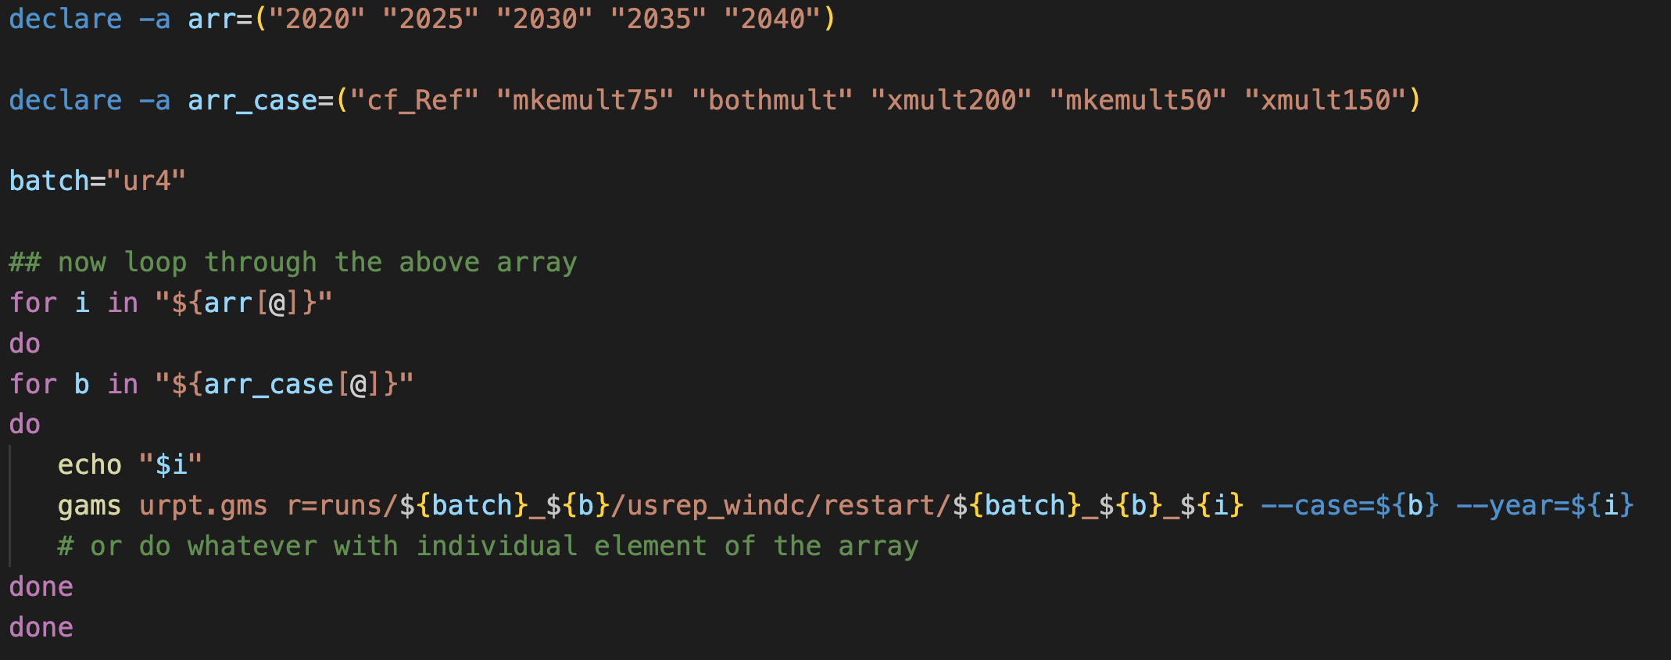
Script of the day (literally from this AM)

Slide 5
Agenda
Practicing GAMS/GitHub
(Very) Simple examples
Review: sparse matrix construction
$ operations on equations, summations, …
Ursula’s utility
Introducing time via Franzi’s Forestry
Elmo’s electricity
Restarts/saves
Then:
Piece-wise linear approximation
Hotelling model of non-renewable resources
Renewable resources modeling:
Fisheries management
(actual) Forestry modeling via Faustman
Non-linear models

Slide 6
Ripley’s restaurant – A very simple model
Ripley works 40 hours per week making hamburgers, hot dogs, and french fries. The net revenue and time to make for each of the items is in the table below.
What is Ripley’s profit-maximizing production choice?
Item | Revenue | Cost | Hours
Hamburger | 1.5 | 0.75 | 0.5
Hot dog | 0.75 | 0.1 | 0.2
French fries | 0.25 | 0.05 | 0.1

Slide 7
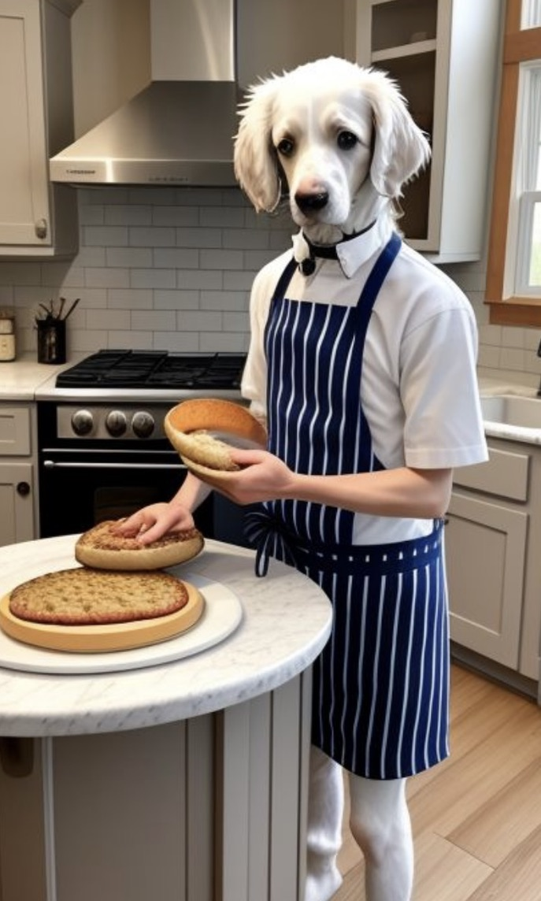
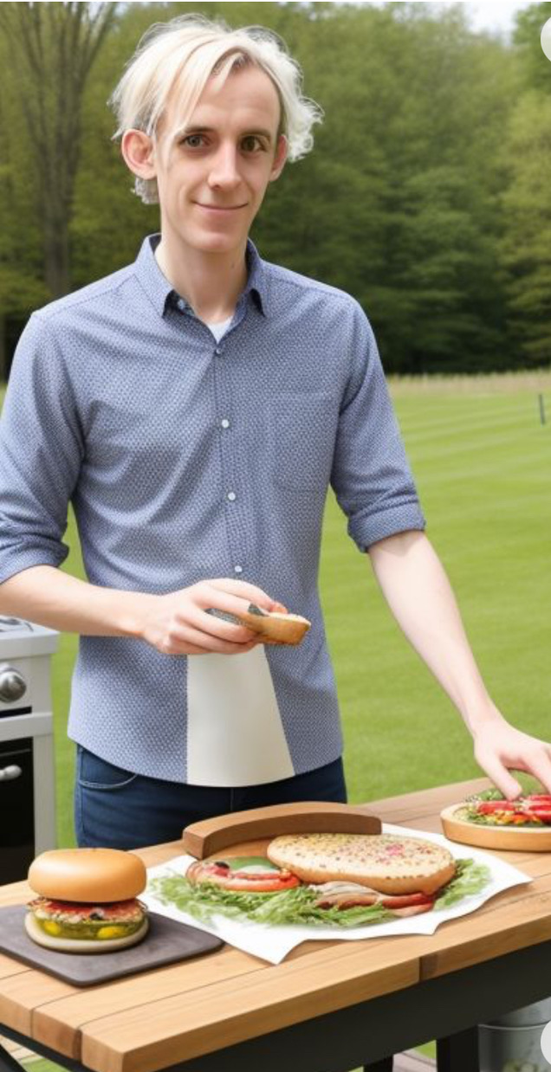
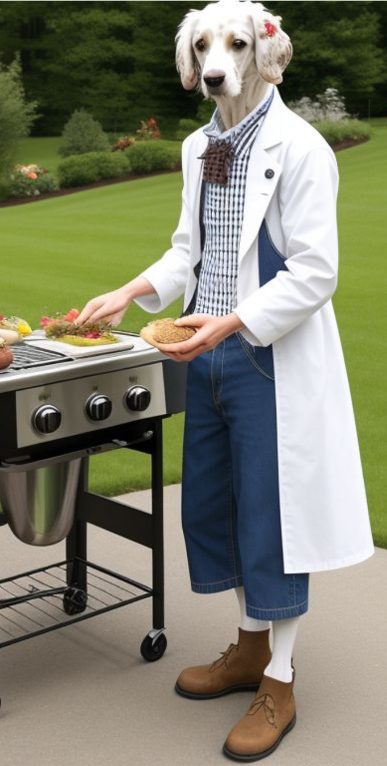
Ripley’s restaurant – visualized by (janky) AI

Slide 8
Writing a model
Always go in this order:
Sets/indices
Parameters
Variables
Objective function
Constraints
See explanation/examples in INFORMS (Grievel et al.) or CCS papers

Slide 9
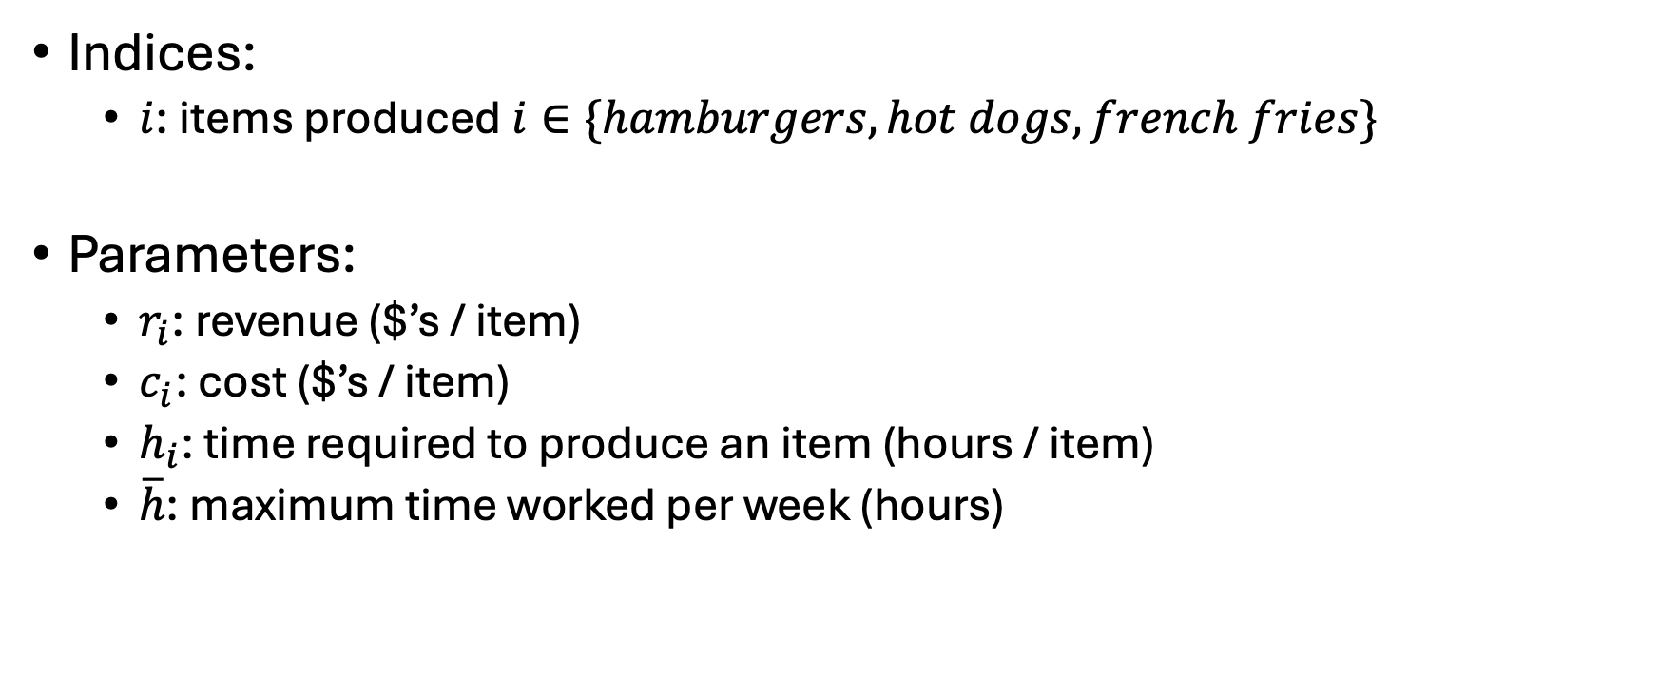
Ripley’s restaurant
Indices:
$i$: items produced $i∈\{hamburgers, hot dogs, french fries\}$
Parameters:
$r_{i}$: revenue ($’s / item)
$c_{i}$: cost ($’s / item)
$h_{i}$: time required to produce an item (hours / item)
$\overline{h}$: maximum time worked per week (hours)
Item | Revenue | Cost | Hours
Hamburger | 1.5 | 0.75 | 0.5
Hot dog | 0.75 | 0.1 | 0.2
French fries | 0.25 | 0.05 | 0.1

Slide 10
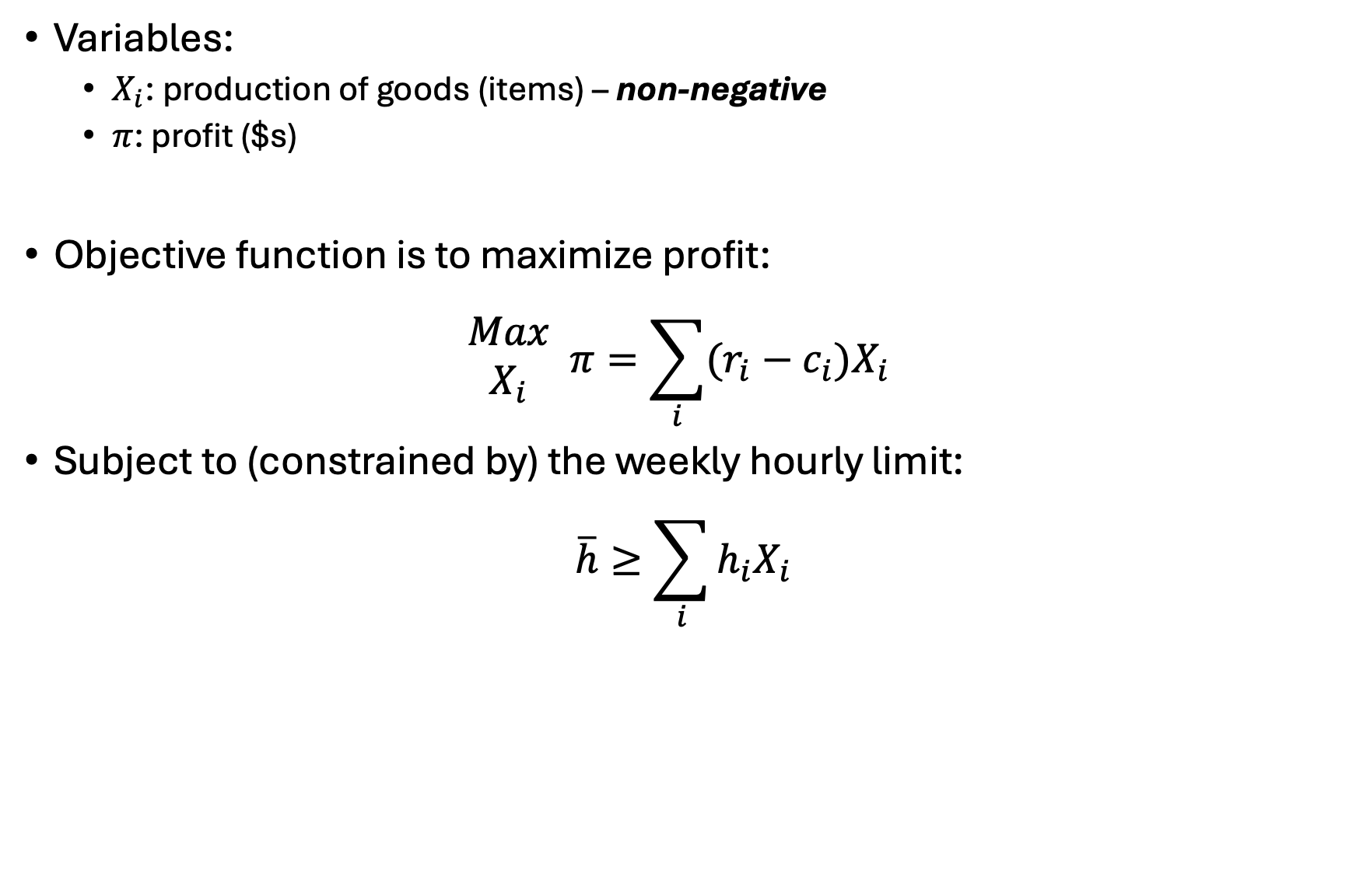
Ripley’s restaurant
Variables:
$X_{i}$: production of goods (items) – non-negative
$π$: profit ($s)
Objective function is to maximize profit:
$$\begin{matrix}Max \\ X_{i}\end{matrix} π=\sum_{i}{(r_{i}−c_{i})X_{i}}$$
Subject to (constrained by) the weekly hourly limit:
$$\overline{h}≥\sum_{i}{h_{i}X_{i}}$$

Slide 11
Ripley’s restaurant
Let’s code this up in GAMS…

Slide 12
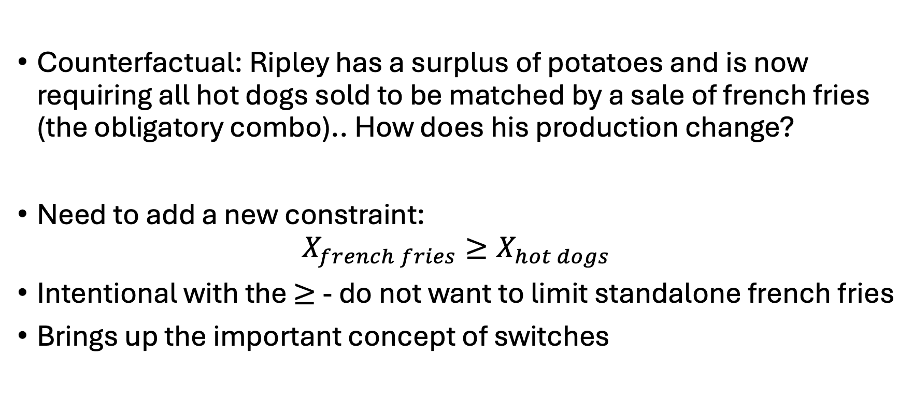
Ripley’s restaurant
Counterfactual: Ripley has a surplus of potatoes and is now requiring all hot dogs sold to be matched by a sale of french fries (the obligatory combo).. How does his production change?
Need to add a new constraint:
$$X_{french fries}≥X_{hot dogs}$$
Intentional with the $≥$ - do not want to limit standalone french fries
Brings up the important concept of switches

Slide 13
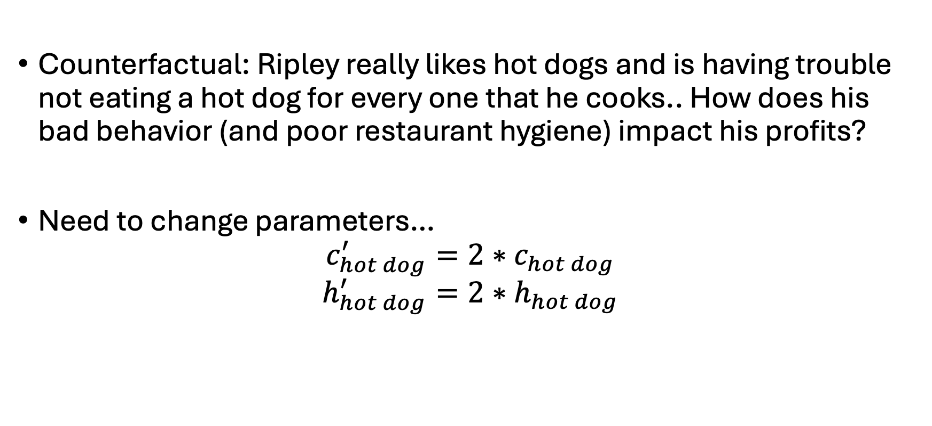
Ripley’s restaurant
Counterfactual: Ripley really likes hot dogs and is having trouble not eating a hot dog for every one that he cooks.. How does his bad behavior (and poor restaurant hygiene) impact his profits?
Need to change parameters…
$$c_{hot dog}^{′}=2∗c_{hot dog}$$
$$h_{hot dog}^{′}=2∗h_{hot dog}$$

Slide 14
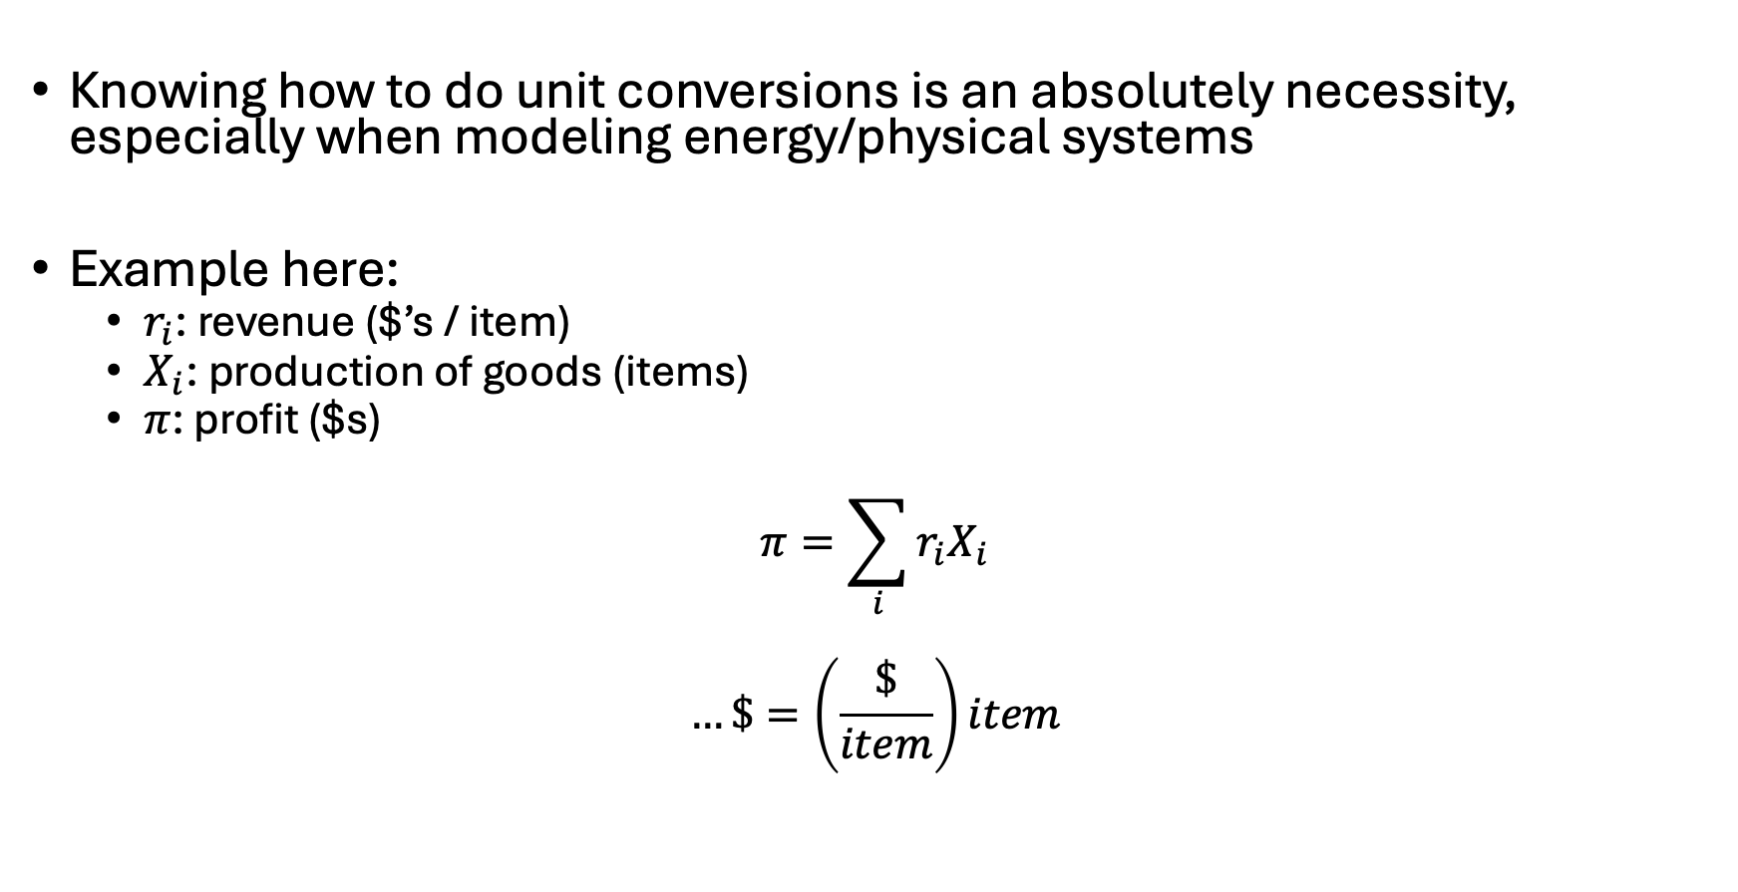
Notes on unit conversions
Knowing how to do unit conversions is an absolutely necessity, especially when modeling energy/physical systems
Example here:
$r_{i}$: revenue ($’s / item)
$X_{i}$: production of goods (items)
$π$: profit ($s)
$$π=\sum_{i}{{r_{i}X}_{i}}$$
$$…\$=\left(\frac{\$}{item}\right)item$$

Slide 15
Sparse matrix construction

Slide 16

Example 2: Ursula’s Utility
Ursula love’s eating pizza and beer. She is at Woody’s and is trying to decide what combination would maximize her utility/happiness. She has $20 in her pocket and forgot her wallet (luckily she’s a regular and they don’t ID her). Each piece of pizza costs $2 and gives her 2 utils of satisfaction while each beer costs $4 and gives her 5 utils of satisfaction. What is Ursula’s utility-maximizing set of consumption choices?
Also – what major utility assumption are we violating? (we’ll revisit this Wednesday)

Slide 17
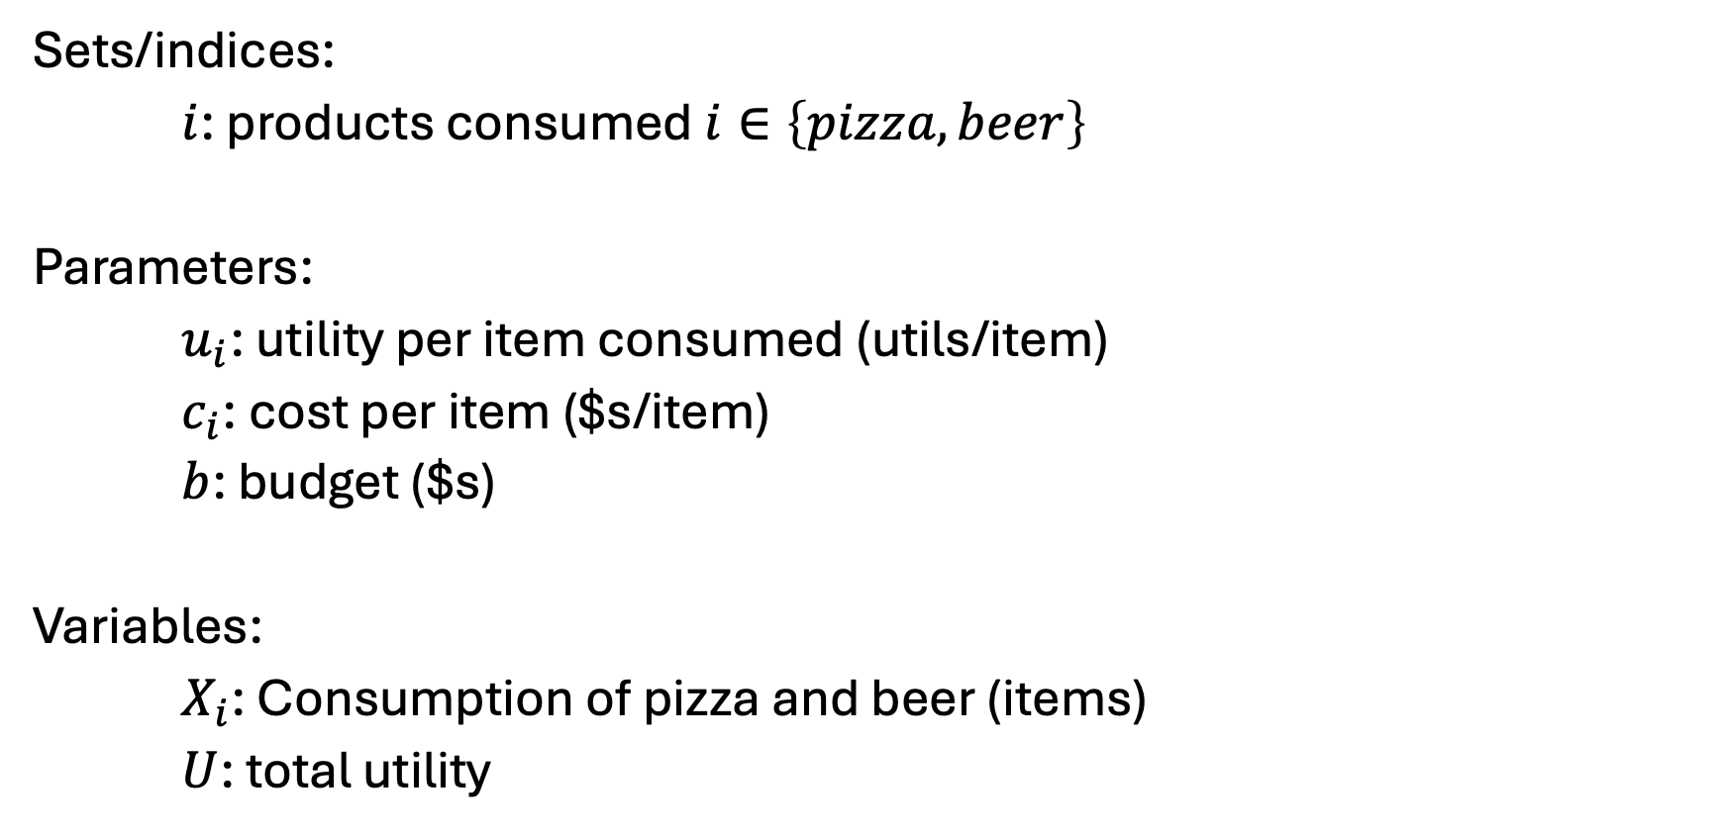
Ursula’s Utility [I] – Sets, parameters, variables
Sets/indices:
$i$: products consumed $i∈\left\{pizza, beer\right\}$
Parameters:
$u_{i}$: utility per item consumed (utils/item)
$c_{i}$: cost per item ($s/item)
$b$: budget ($s)
Variables:
$X_{i}$: Consumption of pizza and beer (items)
$U$: total utility

Slide 18
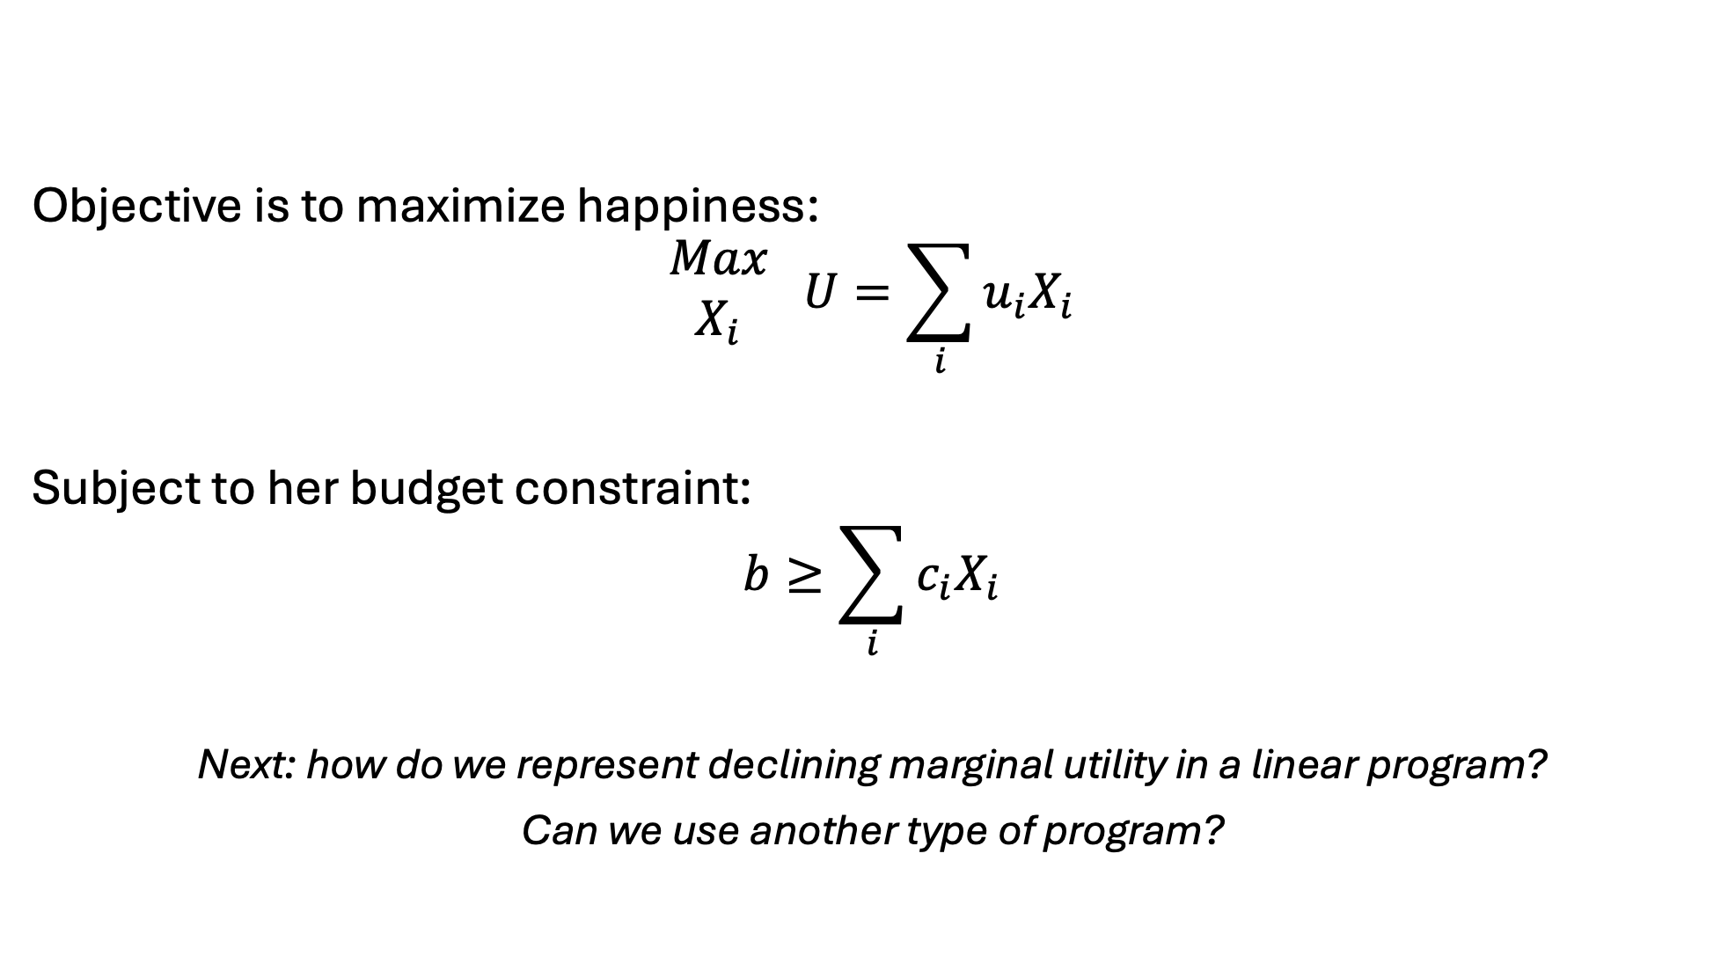
Ursula’s Utility [II] – Objective and constraints
Objective is to maximize happiness:
$$\begin{matrix}Max \\ X_{i}\end{matrix} U=\sum_{i}{u_{i}X_{i}}$$
Subject to her budget constraint:
$$b≥\sum_{i}{c_{i}X_{i}}$$
Next: how do we represent declining marginal utility in a linear program?
Can we use another type of program?

Slide 19

Piece-wise linear approximation
Basically: breaking a nonlinear function into chunks.. Think of Taylor series approximations
Why? To introduce variety
To the board!

Slide 20
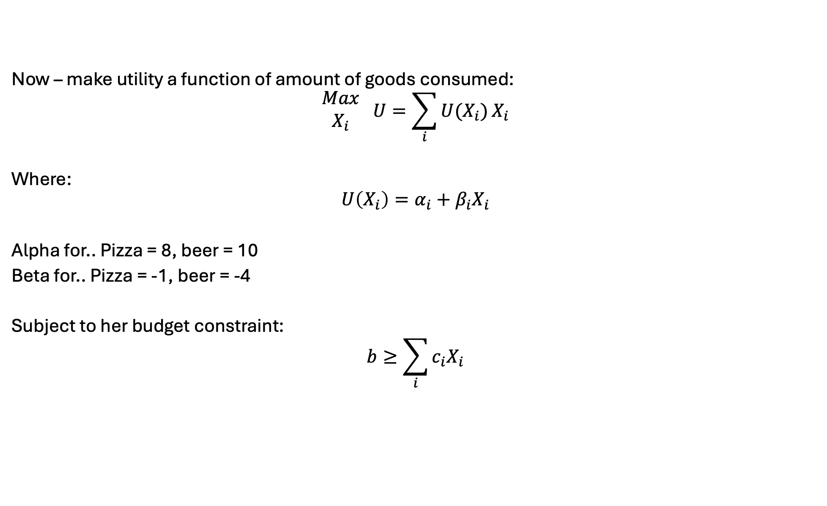
Ursula’s Utility revisited
Now – make utility a function of amount of goods consumed:
$$\begin{matrix}Max \\ X_{i}\end{matrix} U=\sum_{i}{U(X_{i})}X_{i}$$
Where:
$$U\left(X_{i}\right)=α_{i}+β_{i}X_{i}$$
Alpha for.. Pizza = 8, beer = 10
Beta for.. Pizza = -1, beer = -4
Subject to her budget constraint:
$$b≥\sum_{i}{c_{i}X_{i}}$$

Slide 21
Ursula’s Utility – introducing declining utility
Two options –
Quadratically constrained program (QCP)
Basically: polynomial objective function w/linear constraints
Piecewise linear approximation

Slide 22
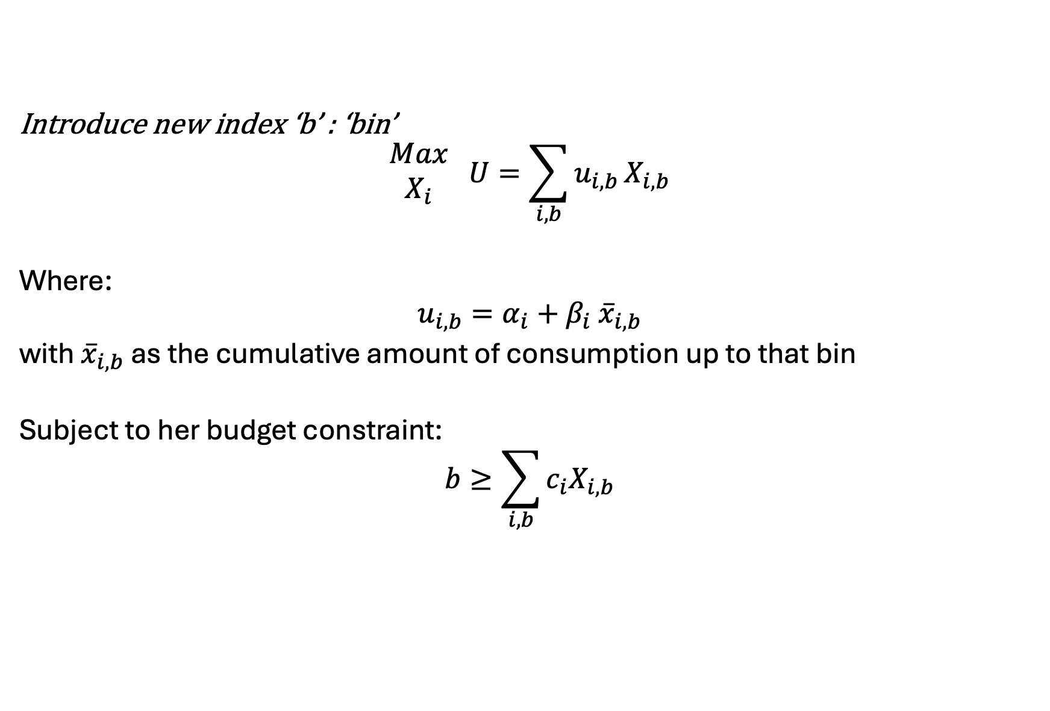
Piecewise linear approximation..
Introduce new index ‘b’ : ‘bin’
$$\begin{matrix}Max \\ X_{i}\end{matrix} U=\sum_{i,b}{u_{i,b}}X_{i,b}$$
Where:
$$u_{i,b}=α_{i}+β_{i} {\overline{x}}_{i,b}$$
with ${\overline{x}}_{i,b}$ as the cumulative amount of consumption up to that bin
Subject to her budget constraint:
$$b≥\sum_{i,b}{c_{i}X_{i,b}}$$

Slide 23

Example 3: Franz Forestry
Franz owns land that produces lumber. Franz makes $100 net profit for every tree cut down. There is an initial stand of 100 trees and the trees grow at 1%* per year. Franz has a discount rate of 2%*. What is Franz profit-maximizing harvesting behavior?
*: Varied in counterfactuals

Slide 24
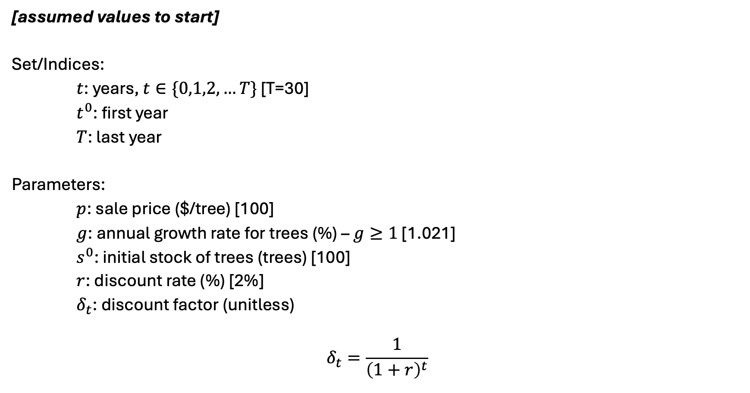
Franz Forestry [I] – sets and parameters
[assumed values to start]
Set/Indices:
$t$: years, $t∈\{0,1,2,…T\}$ [T=30]
$t^{0}$: first year
$T$: last year
Parameters:
$p$: sale price ($/tree) [100]
$g$: annual growth rate for trees (%) – $g≥1$ [1.021]
$s^{0}$: initial stock of trees (trees) [100]
$r$: discount rate (%) [2%]
$δ_{t}$: discount factor (unitless)
$$δ_{t}=\frac{1}{{\left(1+r\right)}^{t}}$$

Slide 25
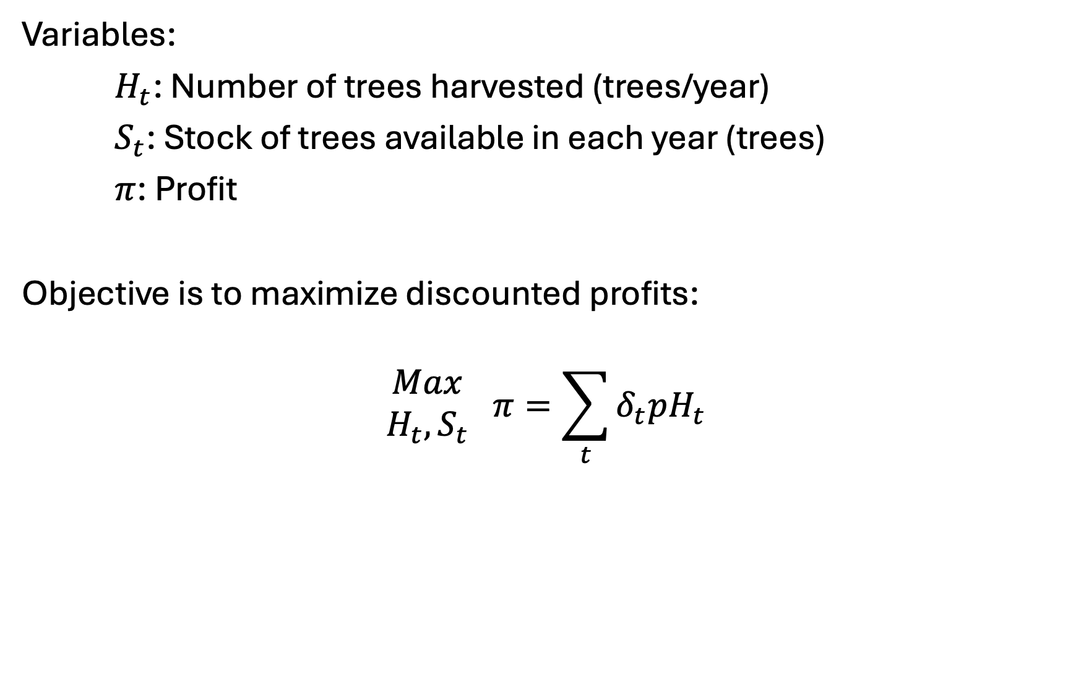
Franz Forestry [II] – variables and objective
Variables:
$H_{t}$: Number of trees harvested (trees/year)
$S_{t}$: Stock of trees available in each year (trees)
$π$: Profit
Objective is to maximize discounted profits:
$$\begin{matrix}Max \\ H_{t},S_{t}\end{matrix} π=\sum_{t}{δ_{t}pH_{t}}$$

Slide 26
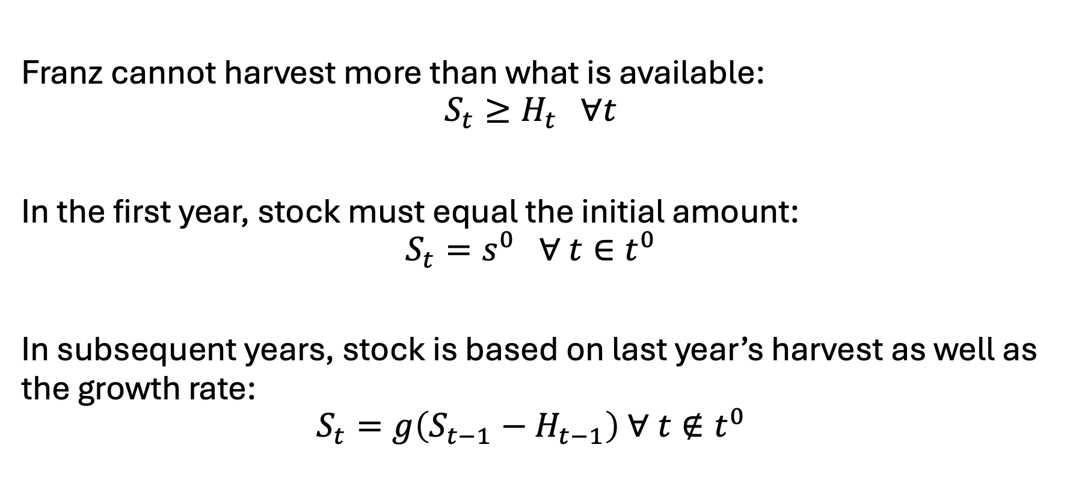
Franz Forestry [III] - constraints
Franz cannot harvest more than what is available:
$$S_{t}≥H_{t} ∀t$$
In the first year, stock must equal the initial amount:
$$S_{t}=s^{0} ∀ t∈t^{0}$$
In subsequent years, stock is based on last year’s harvest as well as the growth rate:
$$S_{t}=g\left(S_{t−1}−H_{t−1}\right) ∀ t∉t^{0}$$

Slide 27
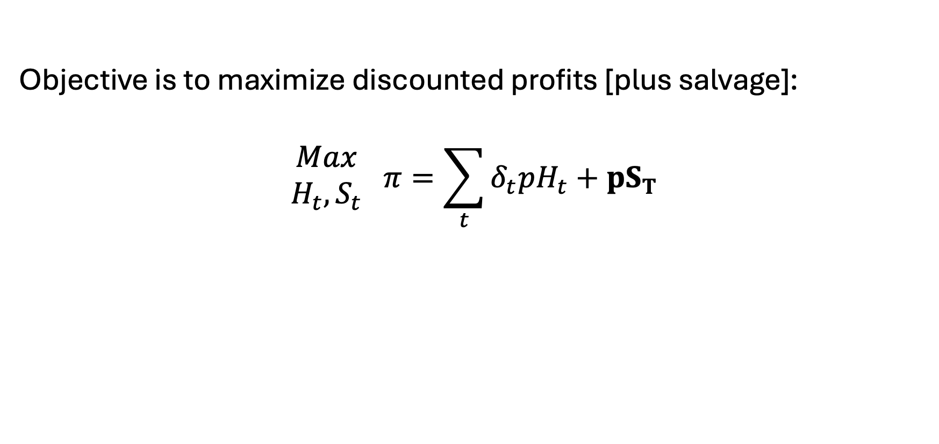
Salvage value?
Objective is to maximize discounted profits [plus salvage]:
$$\begin{matrix}Max \\ H_{t},S_{t}\end{matrix} π=\sum_{t}{δ_{t}pH_{t}}+pS_{T}$$

Slide 28
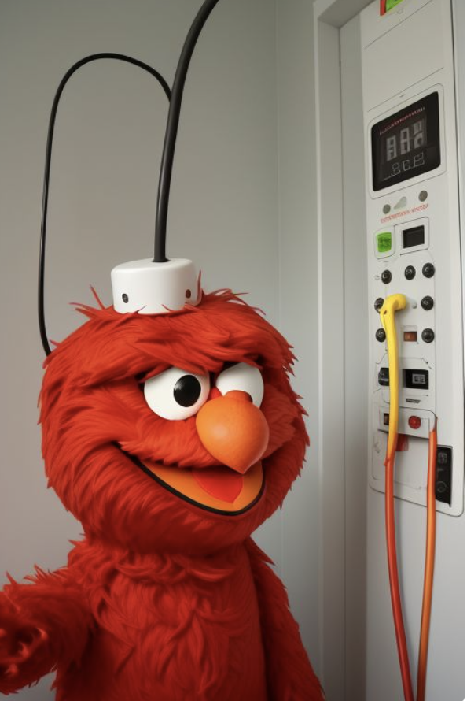
Example 4: Elmo’s Electricity
Elmo runs a small electricity utility. He has three electricity facilities: coal, gas, and wind. Each technology has its own cost and capacity. He must meet the hourly demand of his small town. What is Elmo’s cost-minimizing set of operational decisions?

Slide 29
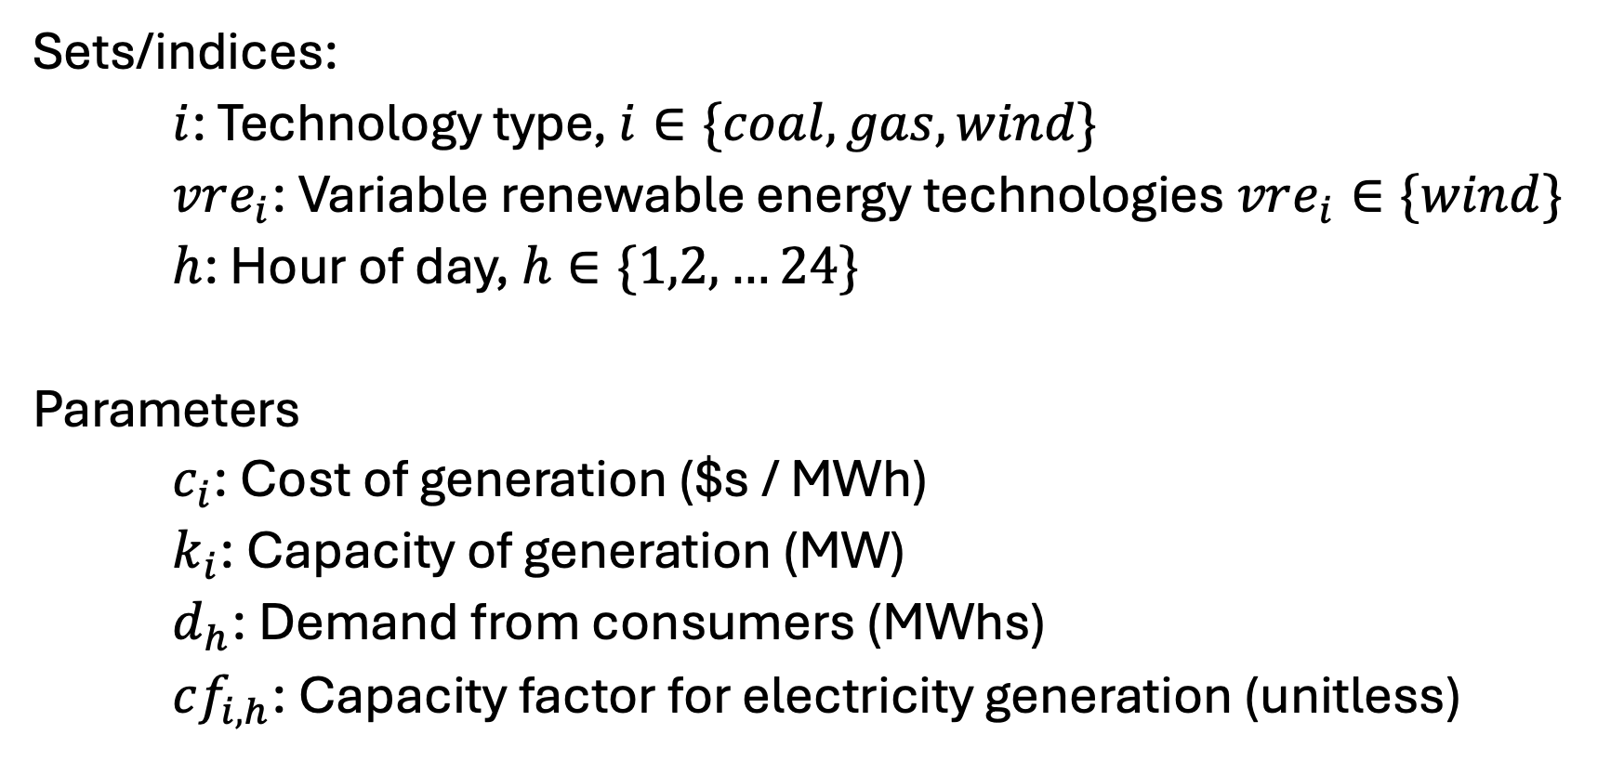
Elmo’s Electricity [I] – Sets and parameters
Sets/indices:
$i$: Technology type, $i∈\{coal, gas, wind\}$
$vre_{i}$: Variable renewable energy technologies $vre_{i}∈\{wind\}$
$h$: Hour of day, $h∈\{1,2,…24\}$
Parameters
$c_{i}$: Cost of generation ($s / MWh)
$k_{i}$: Capacity of generation (MW)
$d_{h}$: Demand from consumers (MWhs)
$cf_{i,h}$: Capacity factor for electricity generation (unitless)

Slide 30
Elmo’s electricity [II] - data
See spreadsheet - EBGN645_Data_Day3.xlsx

Slide 31
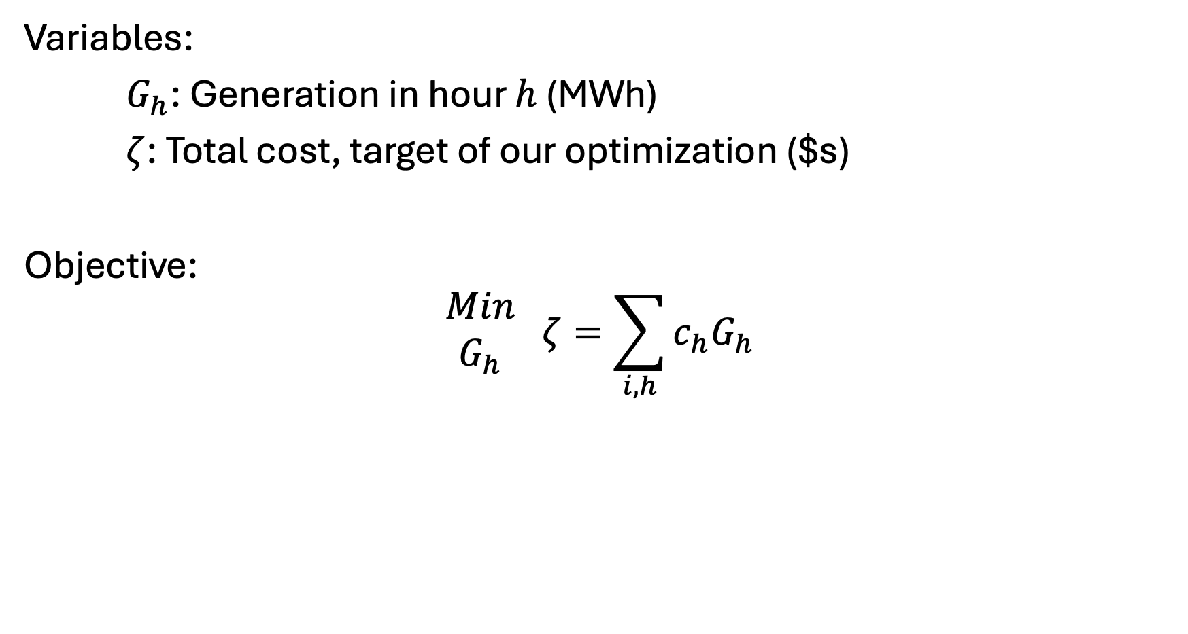
Elmo’s Electricity [III] – Variables and objective
Variables:
$G_{h}$: Generation in hour $h$ (MWh)
$ζ$: Total cost, target of our optimization ($s)
Objective:
$$\begin{matrix}Min \\ G_{h}\end{matrix} ζ=\sum_{i,h}{c_{h}G_{h}}$$

Slide 32
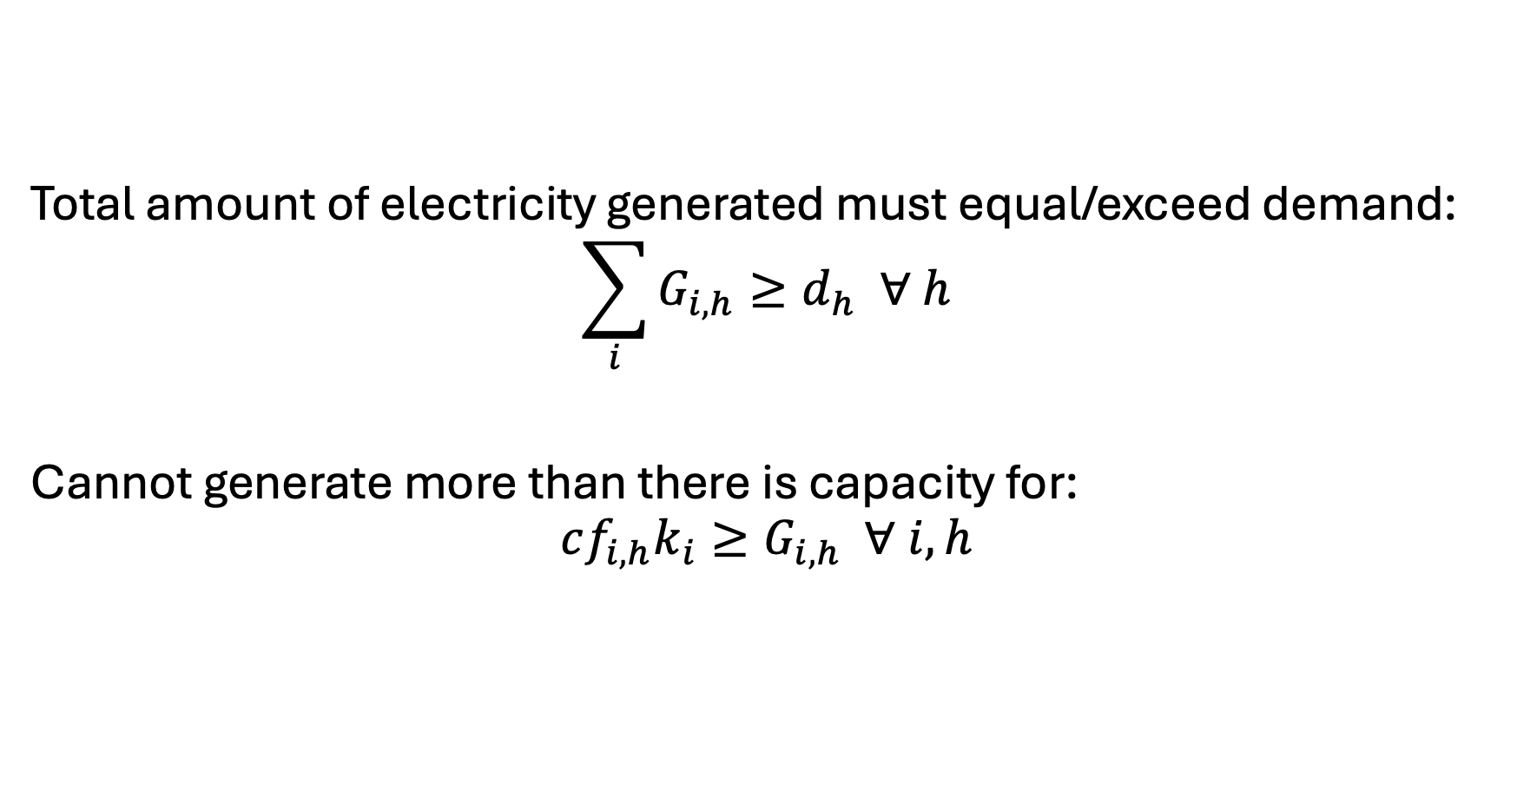
Elmo’s Electricity [IV] - Constraints
Total amount of electricity generated must equal/exceed demand:
$$\sum_{i}{G_{i,h}}≥d_{h} ∀ h$$
Cannot generate more than there is capacity for:
$$cf_{i,h}k_{i}≥G_{i,h} ∀ i,h$$

